Slide 1



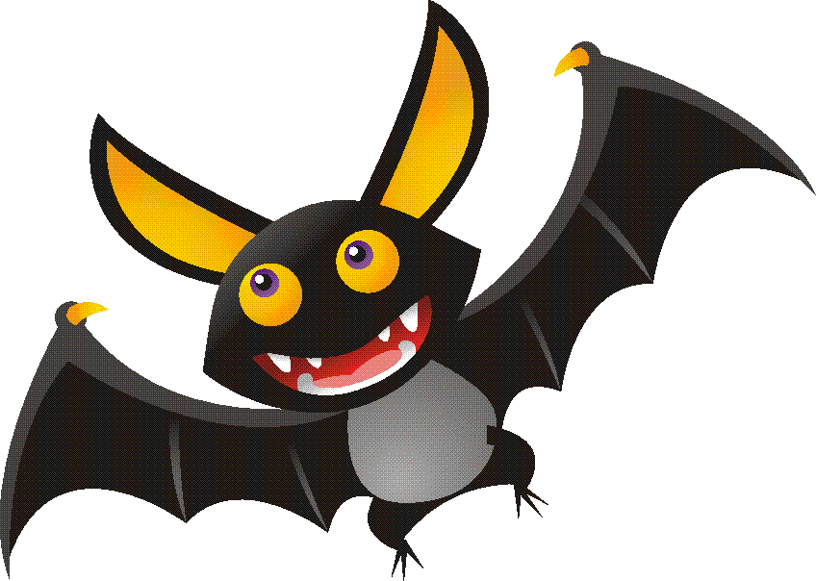
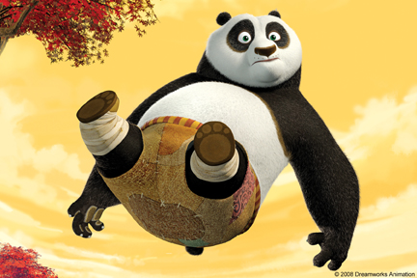
What is the essence of life?
Common Characteristics of Living Things

Slide 2
Identify the common characteristics of living organisms
Highly Organized 严整有序的结构基础
Obtain and Use Energy 新陈代谢能力
Reproduce 繁殖能力
Grow & Develop 生长和发育
Respond to stimuli 应激性
Adapt to the Environment
遗传变异和
适应环境能力

Slide 3
I. Living things are highly organized, from the smallest part to the largest
Membranes
Organelles
Biosphere
Macromolecules
Cells
Ecosystem
Small Molecules
Tissues
Community
Elements
Organs
Species
Atoms
Organisms
Populations

Slide 4
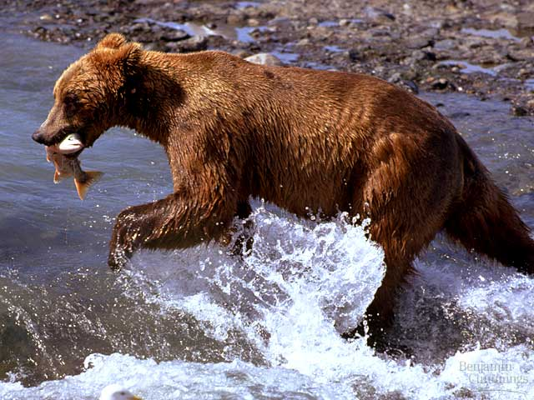
II. Living things have an ability to acquire materials and energy
The energy (usually sugars, proteins) is required for growth and maintenance;
Metabolism involves:
1) Anabolism同化作用: synthesizing
complex substances – acquires energy
2) Catabolism异化作用: breakdown
of complex substances – releases energy

Slide 5
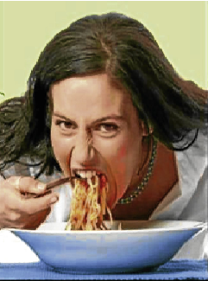
II. Living things have an ability to acquire materials and energy - continued
This ability is called eating, to convert our food to chemicals that our cells can use via metabolism;
Trophic types:
1) Autotrophic: green plants
2) Heterotrophic: animals
The ability must be able to achieve homeostasis: humans maintain a body temperature.

Slide 6
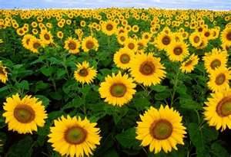
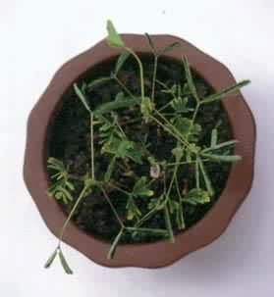
III. Living things have an ability to respond the environmental stimuli
This ability is also called irritability (the ability to react), which results in movement of the individual toward safety. Stimuli could be anything that causes an organism to react.
For example: we learned to avoid hot stoves and busy street when we were young; whereas plants grow up toward the sun, and their roots grow down to search water and minerals.

Slide 7
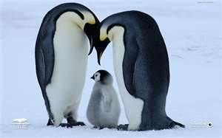

IV. Living things have an ability to reproduce
This ability results in renewal of its own species;
Two kinds of reproduction
1) Asexual reproduction: splitting or budding
2) Sexual reproduction: Union of a sperm
and an egg, causes the great diversity of
genetic biodiversity
3) Some organisms are capable of sexual
and asexual reproduction

Slide 8
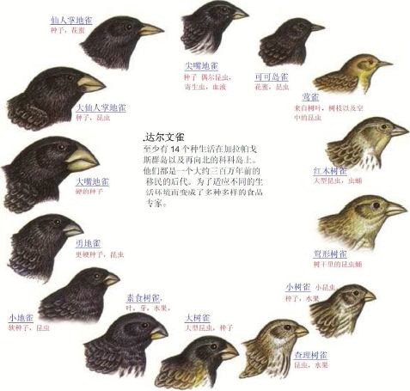
V. Living things have an ability to adapt to the environment
Natural selection allows individuals with better adaptations to survive better and reproduce more;
Heredity can keep species stable, while variation can enable innovation. Heritable variations under natural selection make species evolvable.

Slide 9
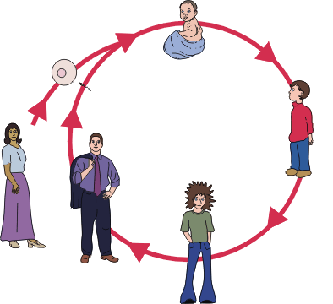
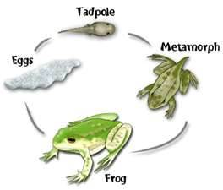
VI. Living things have an ability to grow and develop
Life does not mean getting bigger and bigger;
During growth organisms undergo a cycle of changes (life history) called development;
Bodily maintenance occurs throughtout life. Aging occurs when an organism loses its ability to maintain itself

